Slide 1
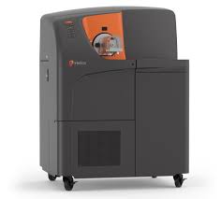

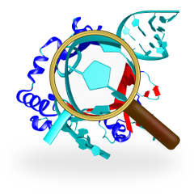
Using CyTOF and Machine Learning to Identify Biomarkers in Immunodeficiency and Cancer Therapy Response
Presenter: Kalyan Srivastava, PhD

Slide 2
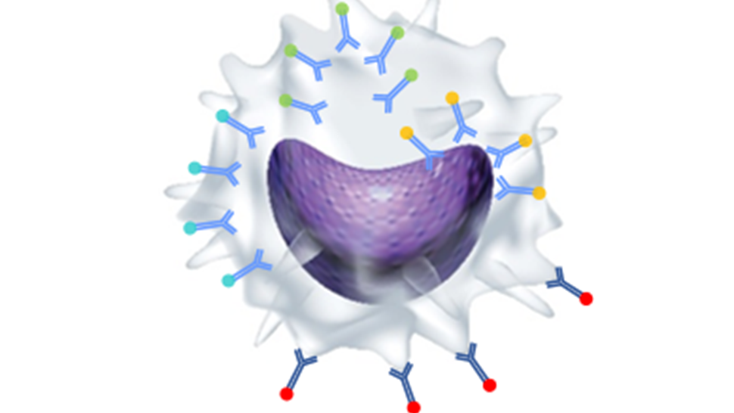
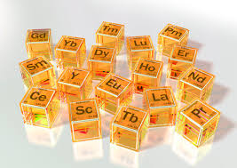
ICP-TOF based Flow Cytometry which uses Lanthanid (3+) metals instead of fluorescent antibody
Cytof introduction
No need to do compensation correction
No background correction
Can read up to 50 antibodies
Generates FCS 3.0 data like flow cytometry data
Requires traditional gating (flowJo) and dimensionality reduction (R/Bioconductor) based analysis

Slide 3

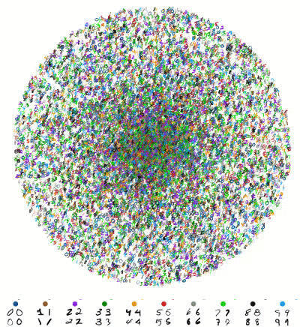
Dimensionality reduction as unsupervised ML
Dimensionality reduction viSNE (tSNE) to Traditional analysis (Dr-to-Tr) approach was applied for further analysis
DR approaches such as viSNE, X-shift, UMAP, ISOMAP and PCA are common
Dimensionality reduction using viSNE (biological adaptation of tSNE) analysis utilizing R/Bioconductor’s cytofkit software
Data merging was done using minimum value of 5000 a.k.a down sampling
Cell progression was done using isomap to complete the map, cluster visualized using clusterX

Slide 4
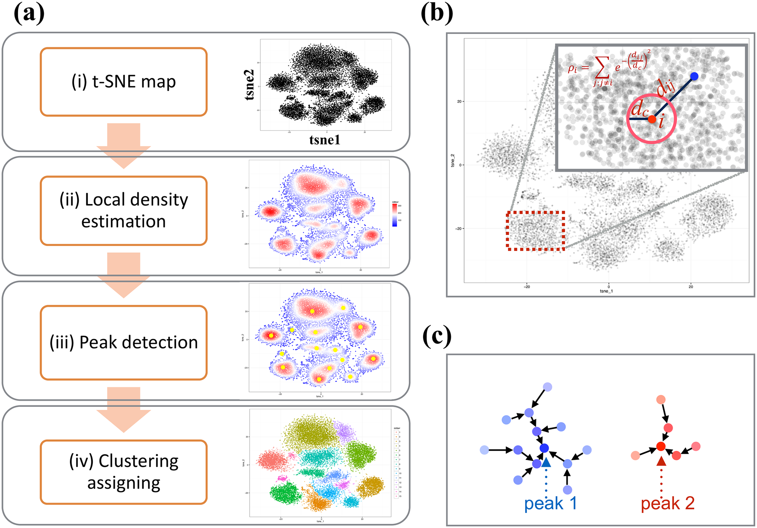
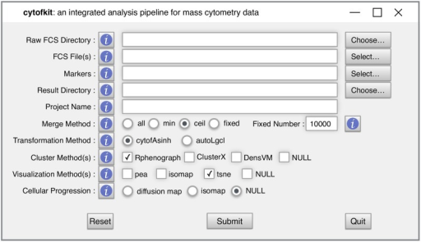
Cytofkit: A Bioconductor Package for an Integrated Mass Cytometry Data Analysis Pipeline
library(“cytofkit”)
cytofkit_gui()
Alternatively Rtsne, Opentsne, FlowJo Plugin

Slide 5
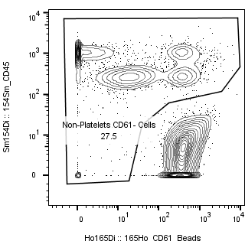
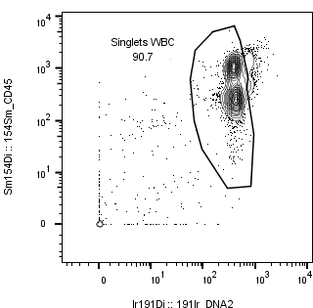
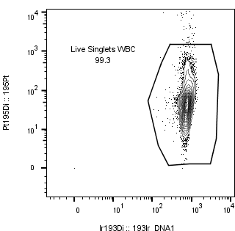
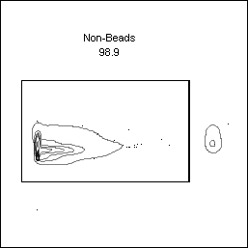
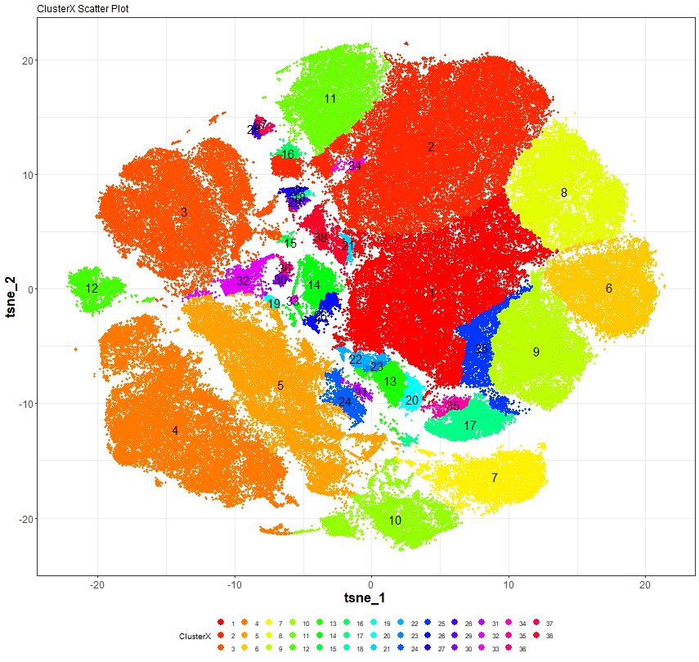
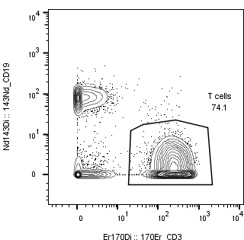
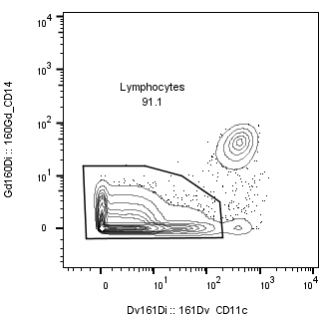
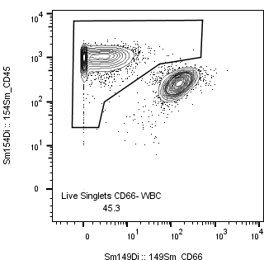
T Cells visne analysis
ND vs CVID - DATA CLEANING AND EXPORTING

Slide 6
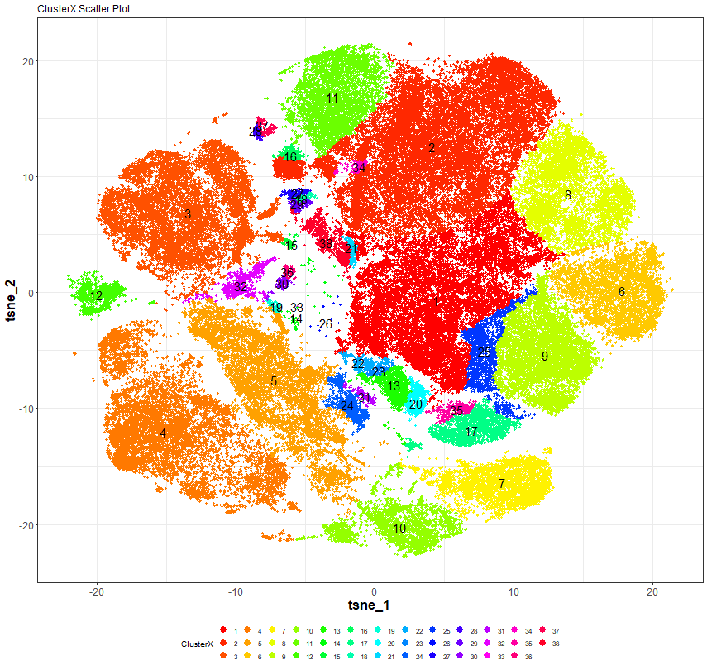
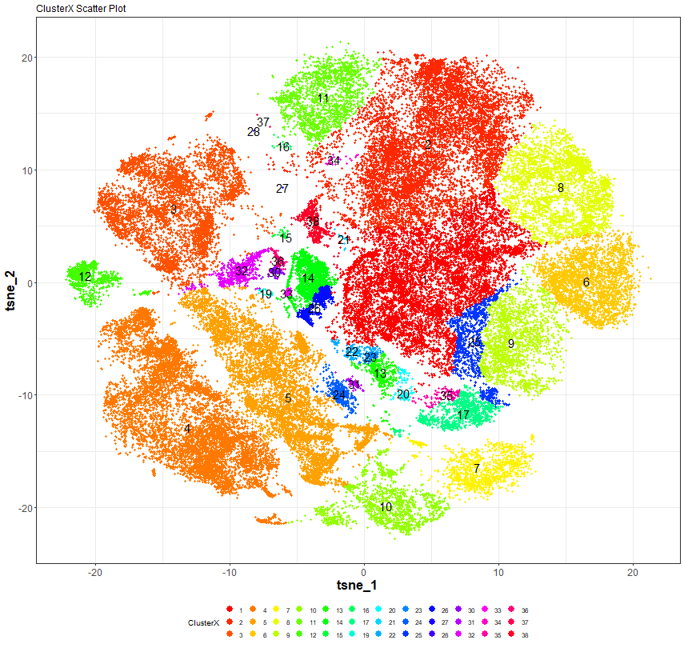
viSNE ANALYSIS MAP
ND vs CVID
Normal Donor
CVID
Normal Donor | CVID
37 | 14
28 | 26
16
27
29
20
19
35

Slide 7
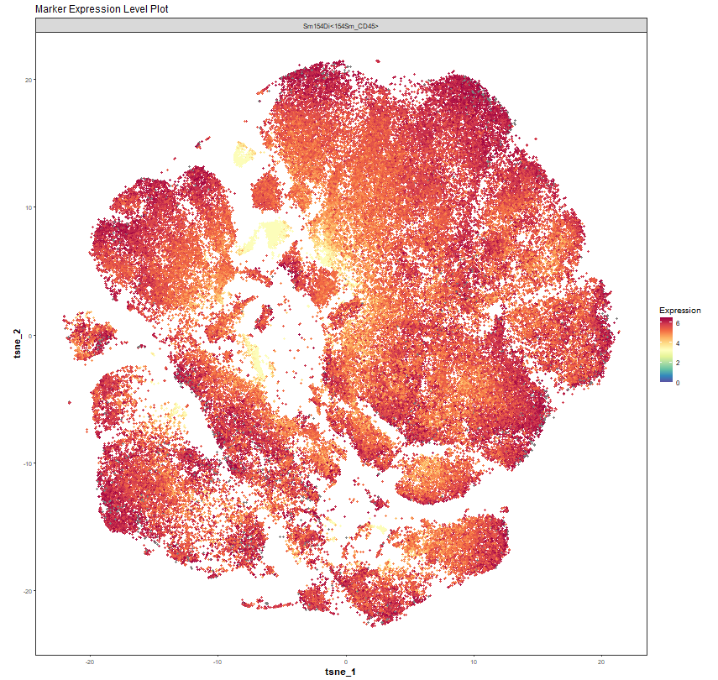
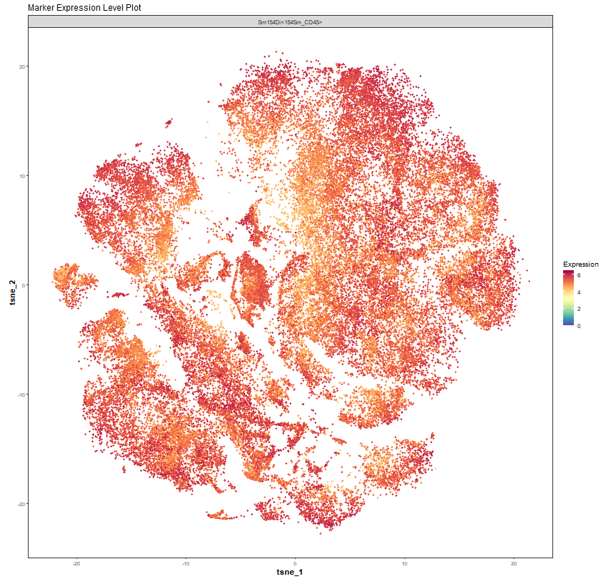
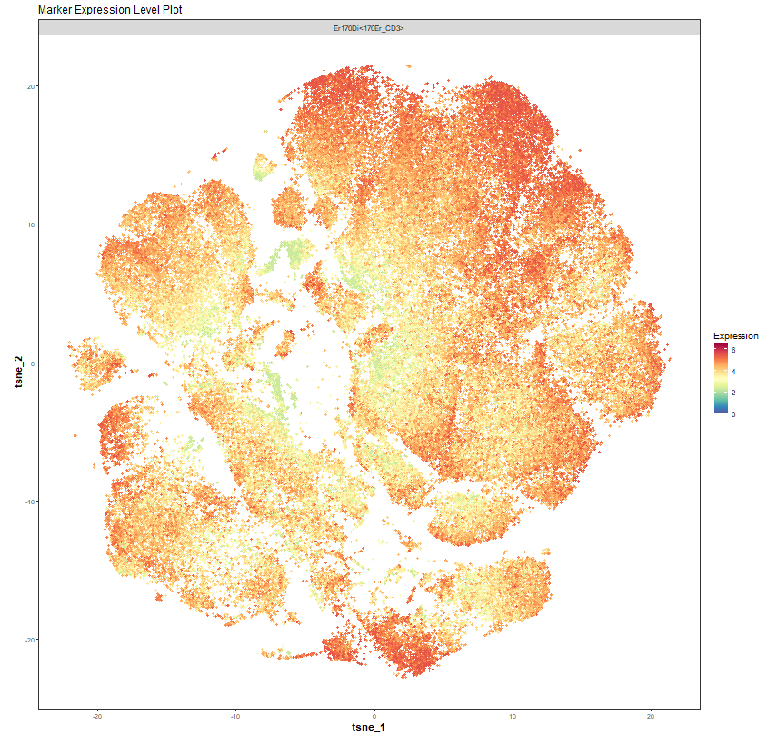
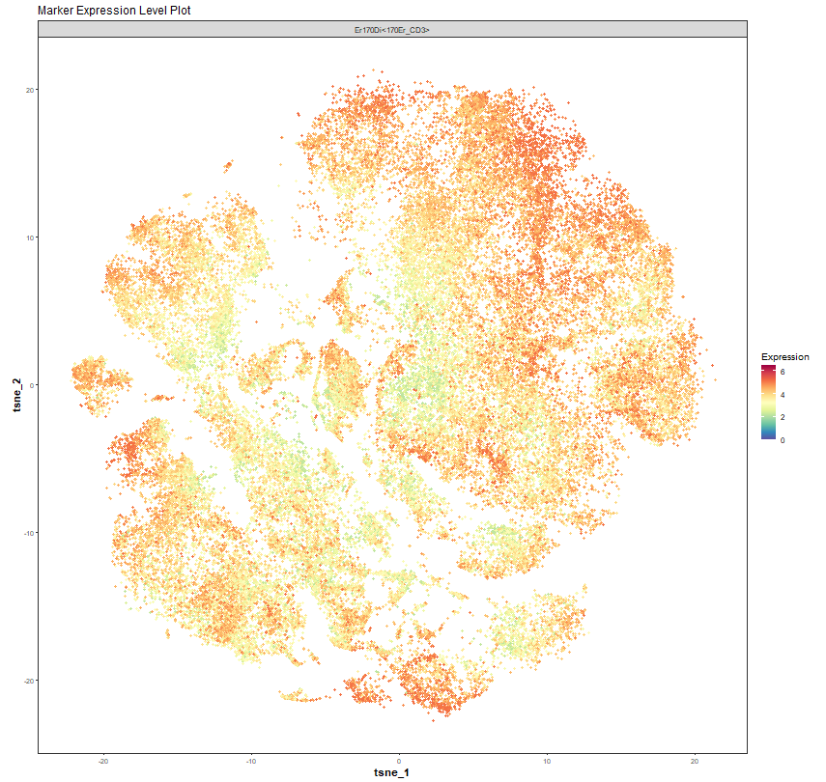
CD45
CD3
ND
CVID

Slide 8
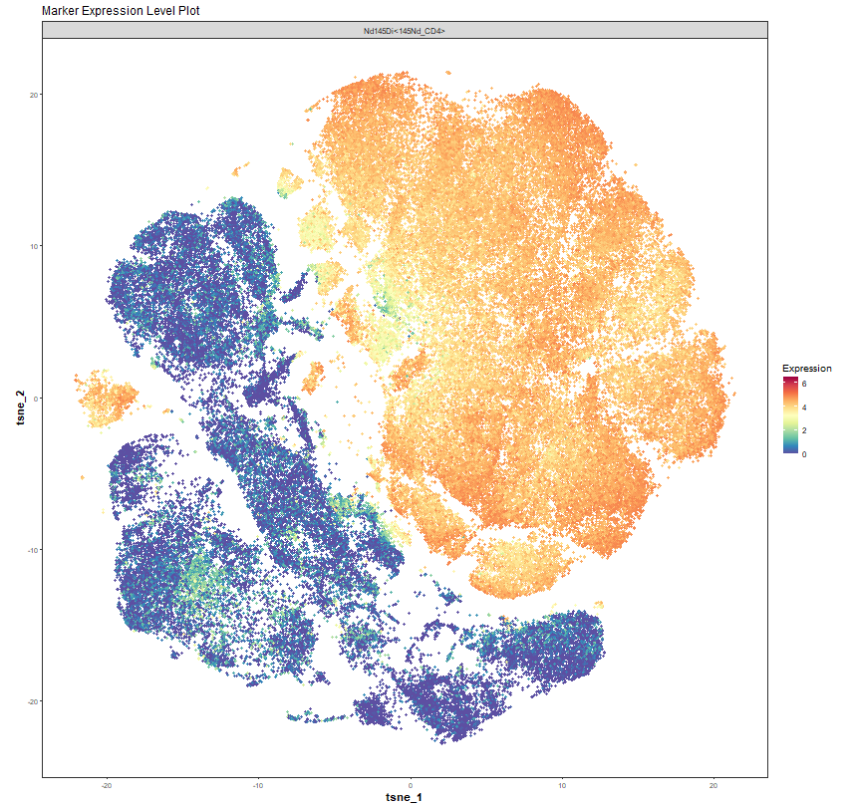
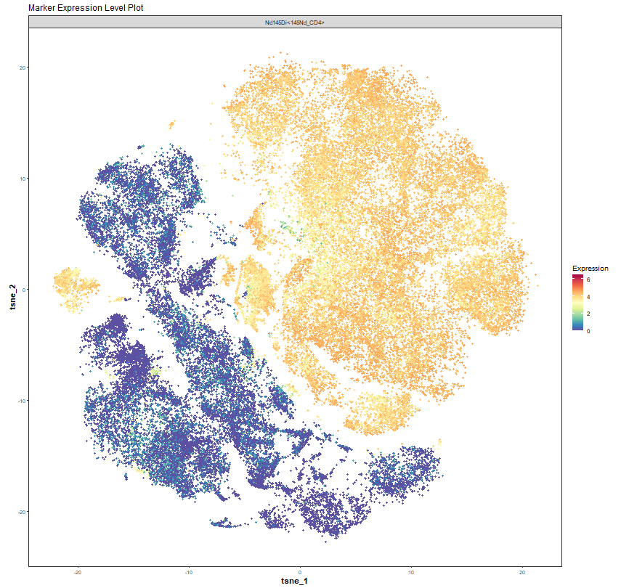
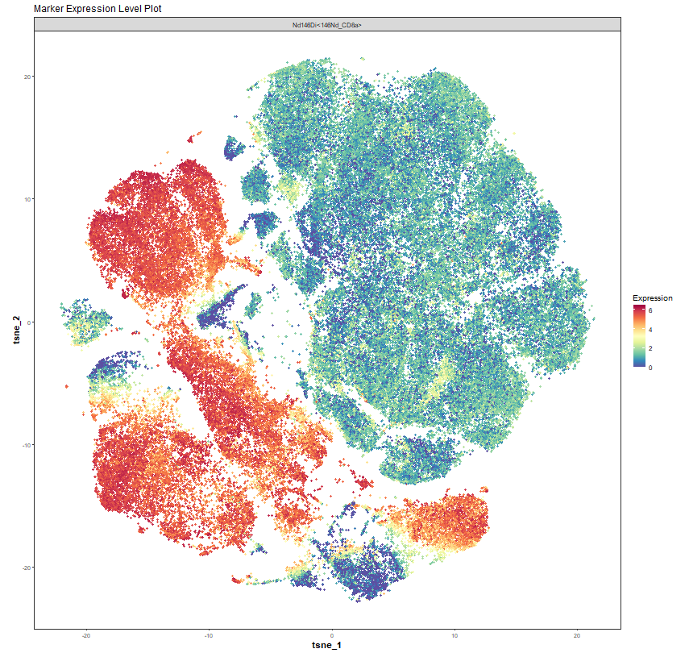
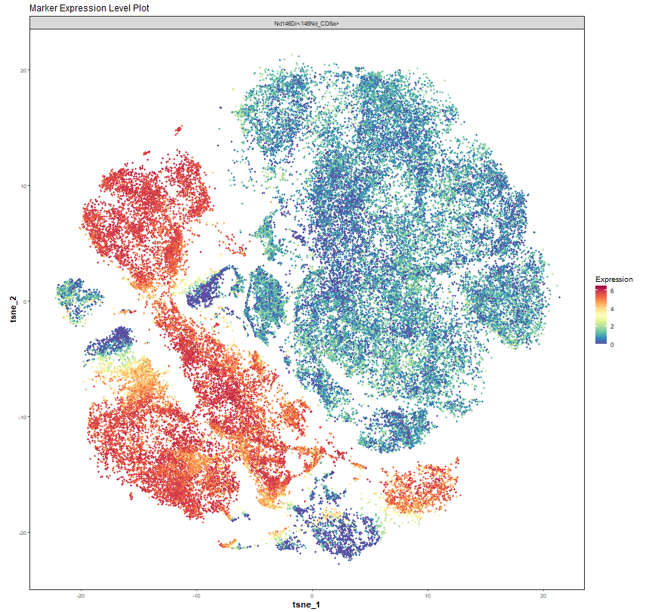
CD4
CD8

Slide 9
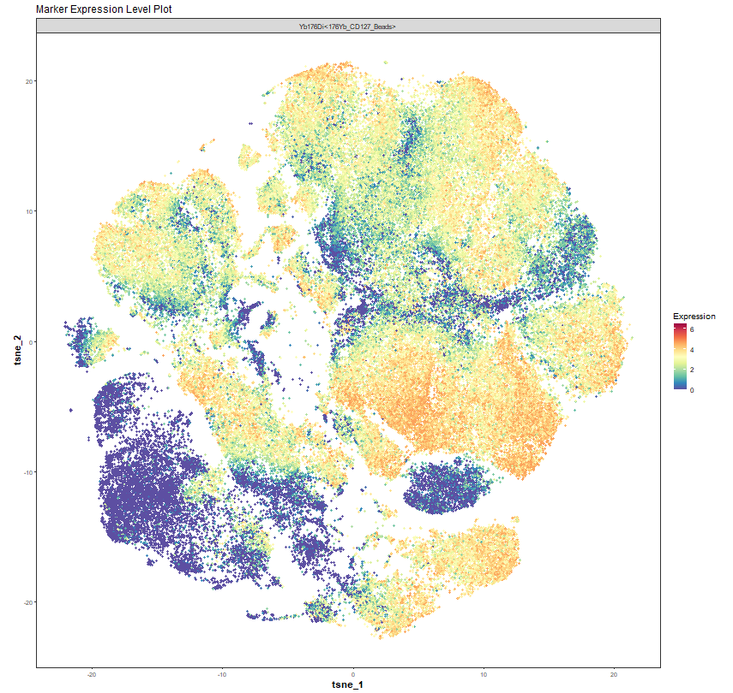
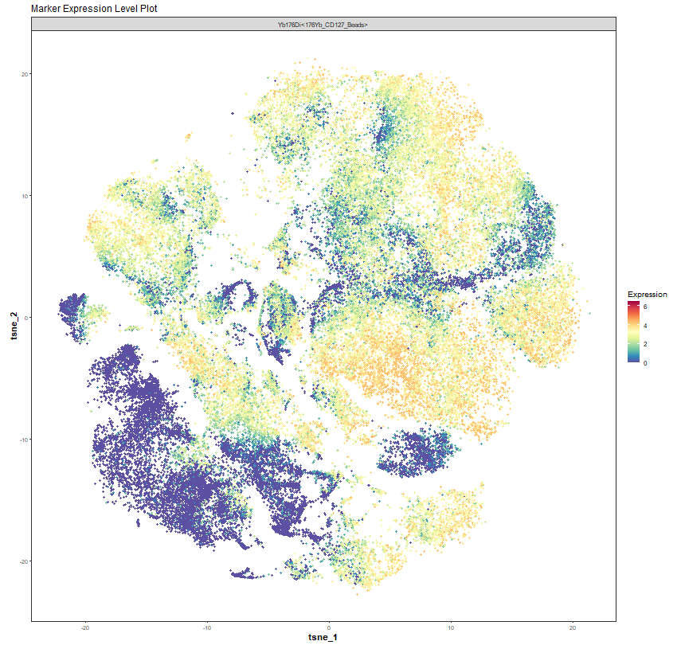
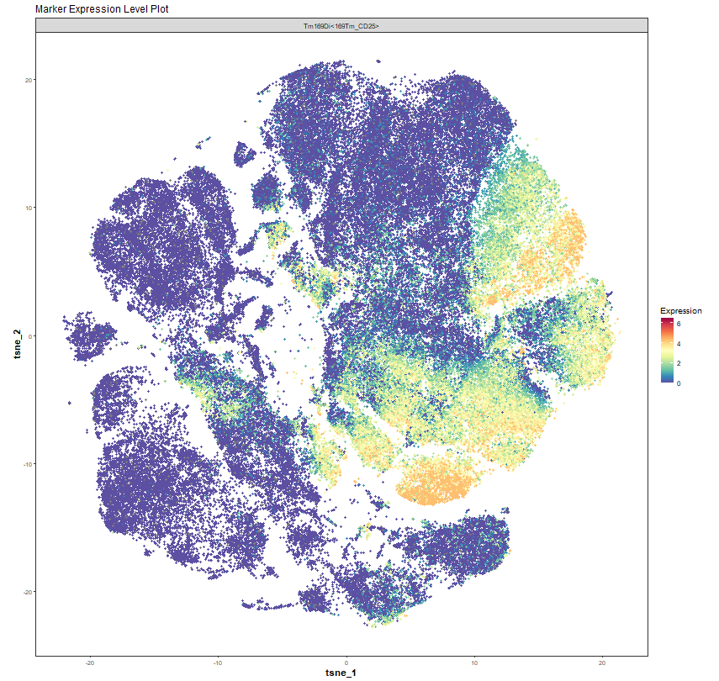
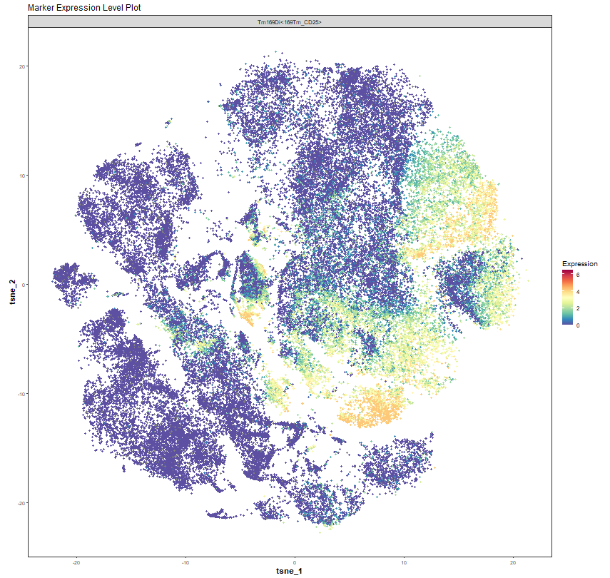
CD127
CD25

Slide 10
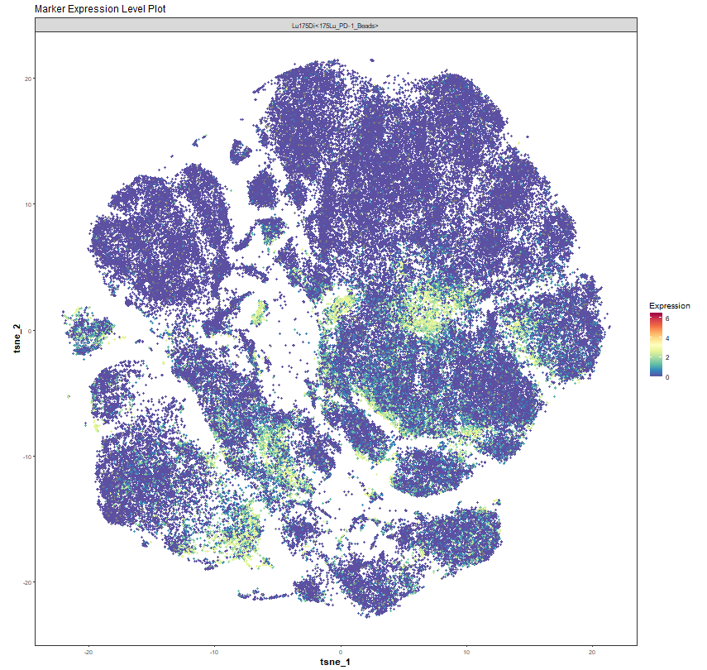
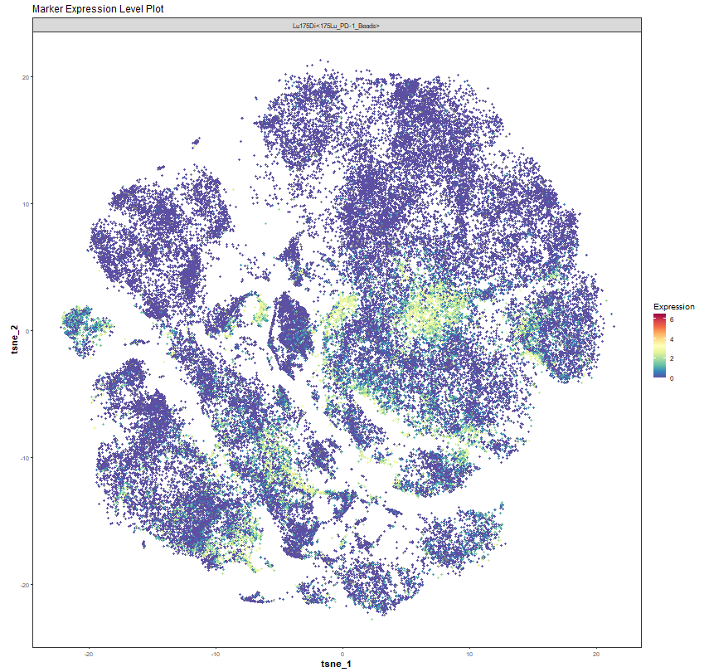
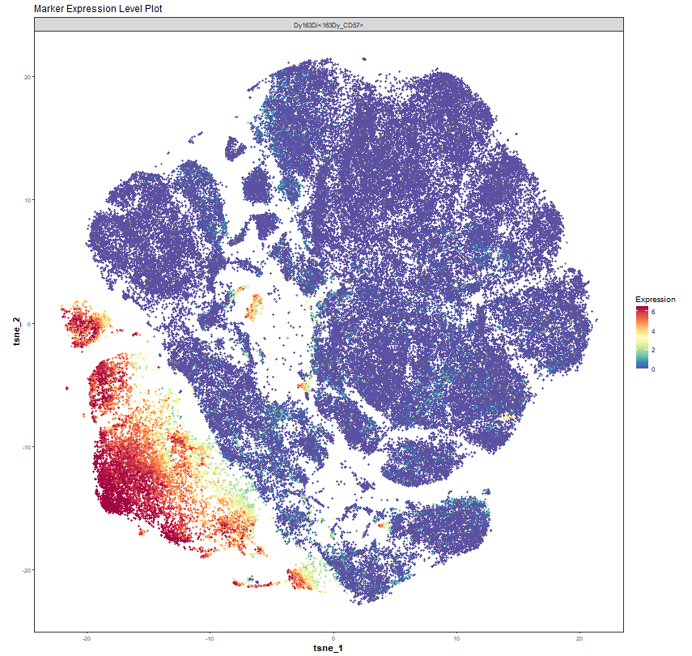
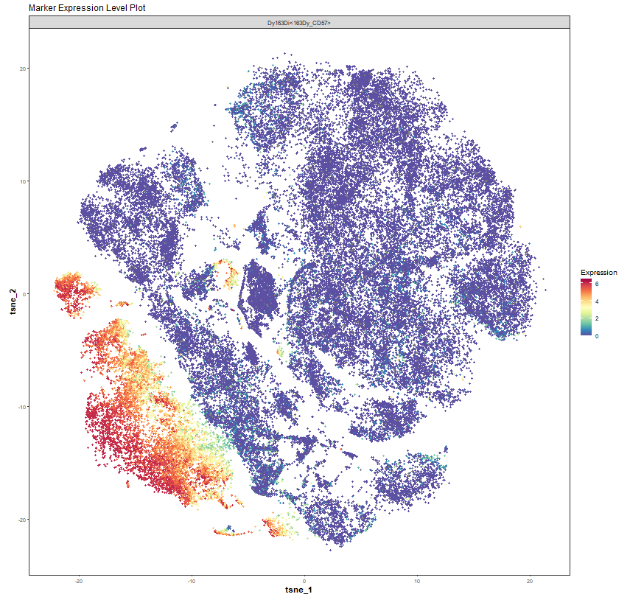
PD-1
CD57

Slide 11
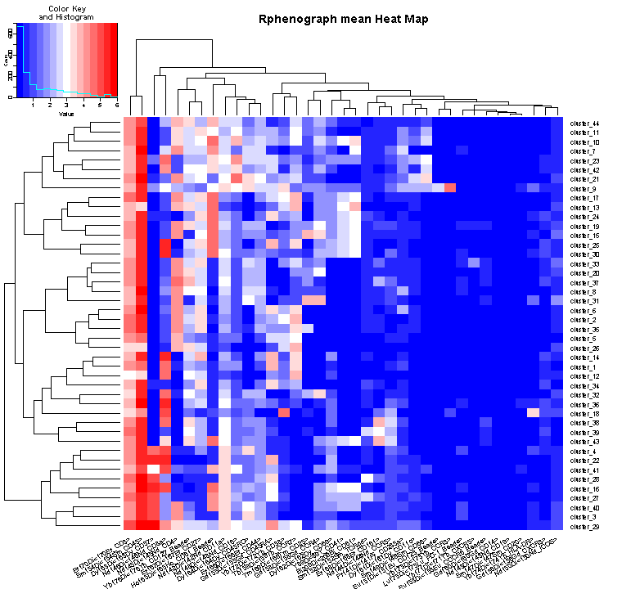
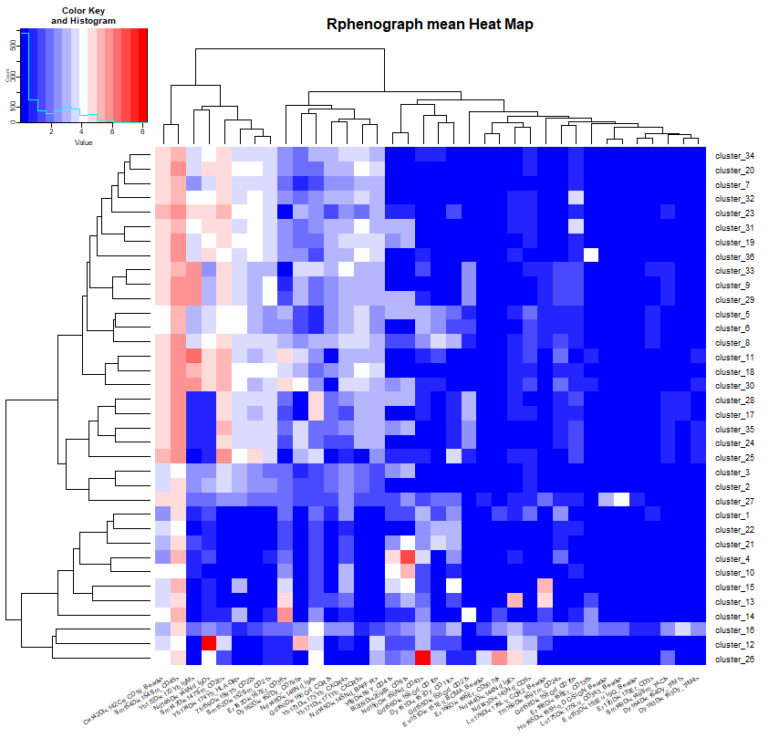
viSNE HEATPLOT
ND
CVID

Slide 12
Summary of Cluster Number and Level of Expression of Protein
Cluster 37: CCR7hi CXCR5- CM Helper T Cells
Cluster 28: CCR7hi CXCR5- CCR4+ CM Helper T
Cluster 16: CCR7hi CD27hi CCR5lo CXCR5- CM Helper T Cells
Cluster 27: CXCR5hi CCR7hi CXCR5hi CM Helper T
Cluster 29: CD25hi CCR7hi CXCR5- CCR5lo CM
Cluster 20: PD-1+ Th17 T Cells
Cluster 35: CD16hi CCR6+ CCR7+ ICOS+ EM Helper T
Cluster 14: CD4+ Naïve T cells
Cluster 26: CCR7+ ICOS+ CD16+ Treg T Cell
Conclusion: CyTOF combined by machine learning helped us in identifying proteomics based biomarkers that are useful
In both test and therapeutics development in CVID. It demonstrated the presence of Tregs and Naïve T cells subtypes and
Absence of Th17 and helper T cells subtypes in CVID patient.

Slide 13
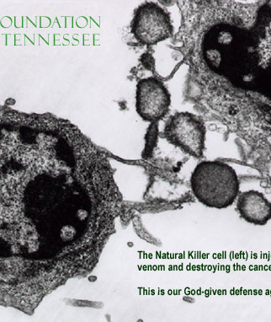
Introduction to Natural Killer Cells
Natural killer (NK) cells are large granular lymphocytes (Type 1 ILCs) mostly synonymous but not limited to with anti-tumor and antiviral immunity
The mature NK cells express CD56 surface marker. The early NK progenitor cells do not express CD56. Terminally mature NK cells express CD43 and CD11b.
Play role in immune-surveillance to detect the defective cells not expressing MHC-I
In human, NK cells also express CD16, whose expression increases upon maturity. Total NK cell population can be differentiated between CD56hi and CD56dim population, giving rise to three population (CD56hi CD16-, CD56hi CD16+ and CD56lo CD16+)
NK cells highly express NKRs (e.g KIRs and NKPs) which are can be activating or inhibitory. NKRs are also expressed in non-NK cell populations.
Recently being highlighted for cancer immunotherapy
Possible roles in adaptive immune response, phagocytosis, antigen presentation, transplant, acute phase response and sepsis.
Target specificity and absence of exaggerated cytokine release makes them good agent for immunotherapy

Slide 14
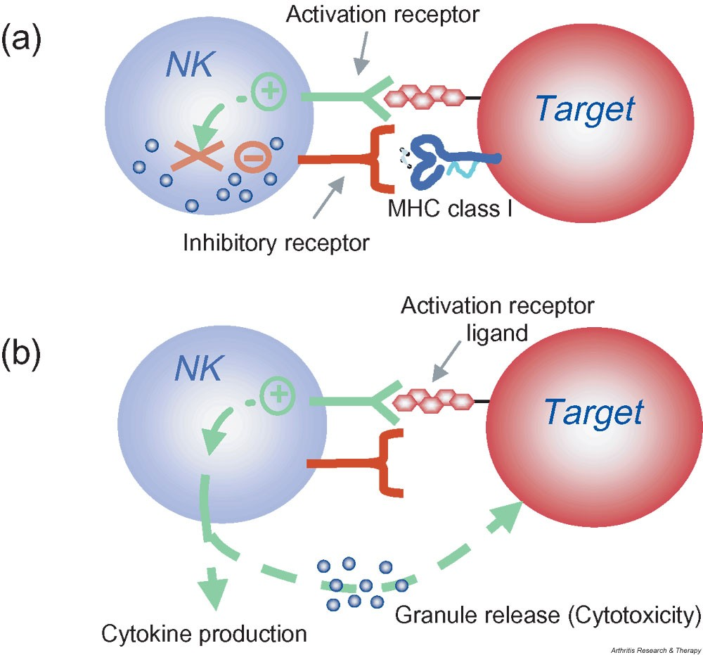
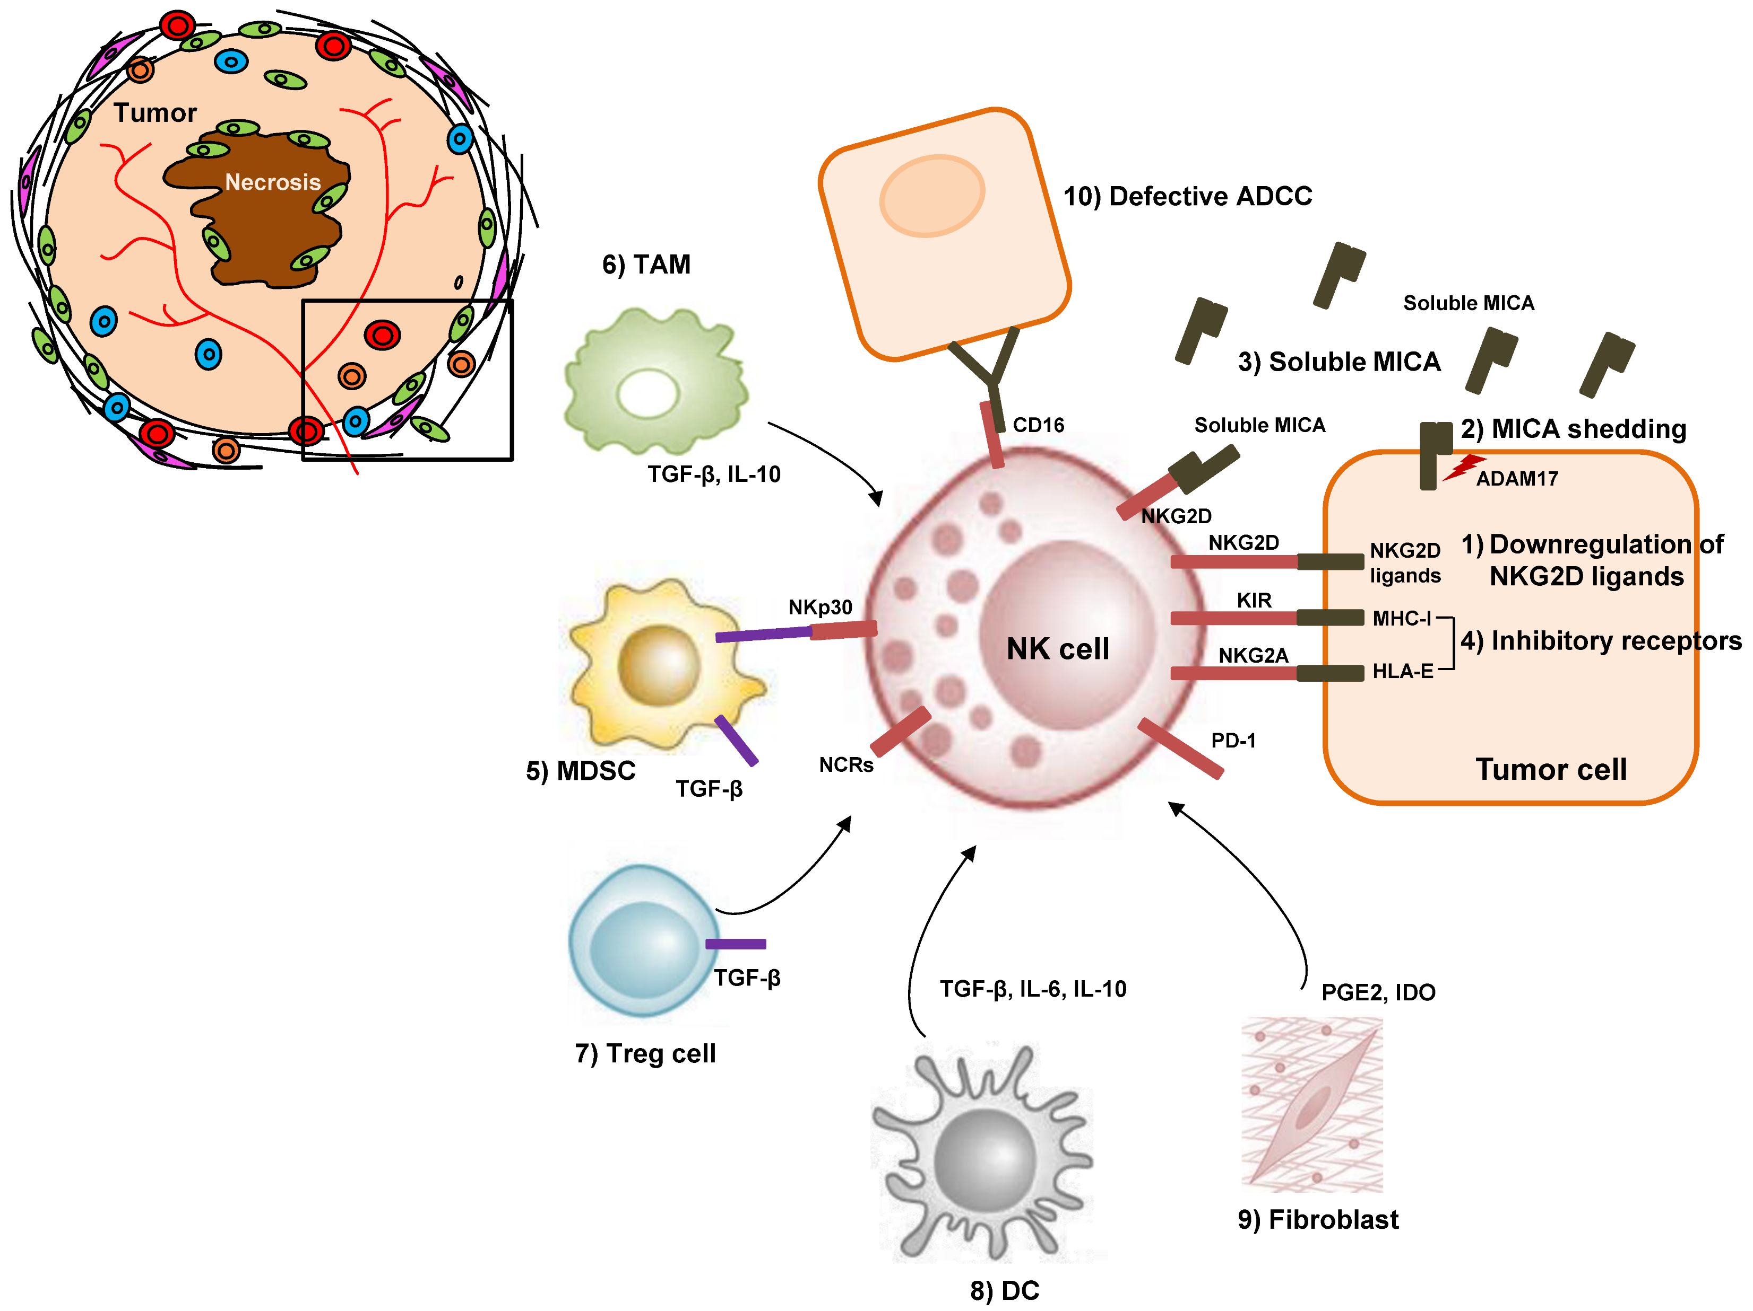
Normal Natural Killer Cells activation and evasion in hepatic cell carcinoma
Outline of NK cell activation
Mitigation of NK cell response in cancer

Slide 15
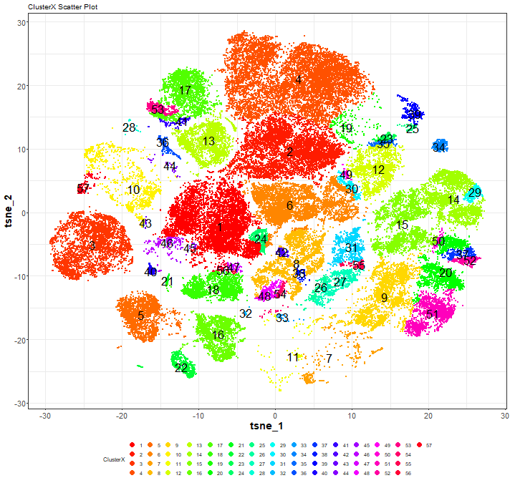
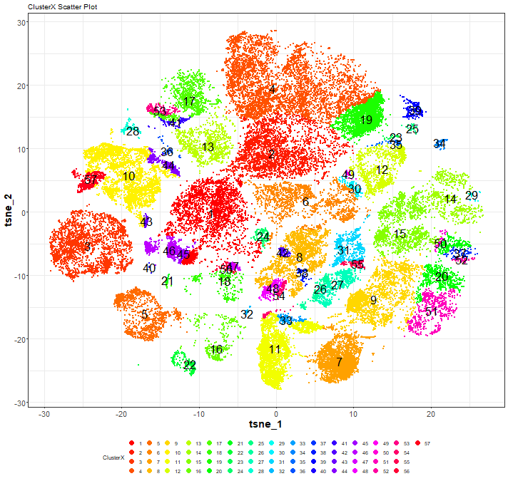

viSNE for pre and post treatment
Before
After
Tx with Tecentric, Opdivo and Keytruda: Pre and Post

Slide 16
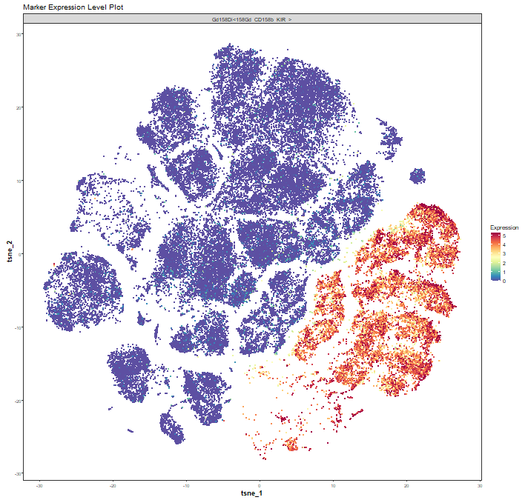
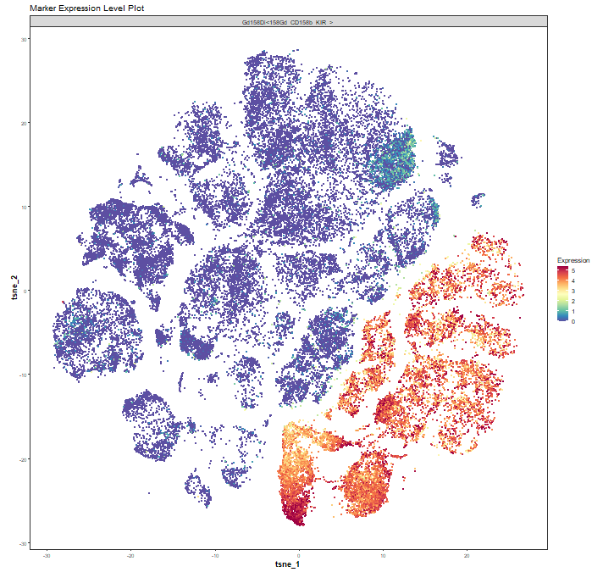
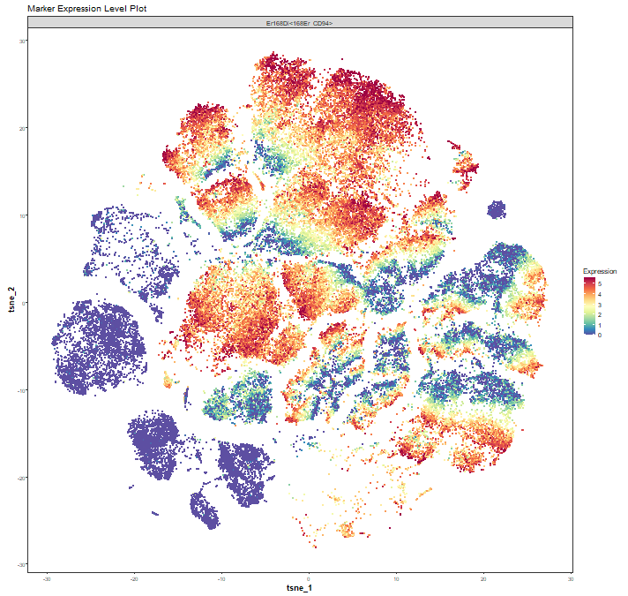
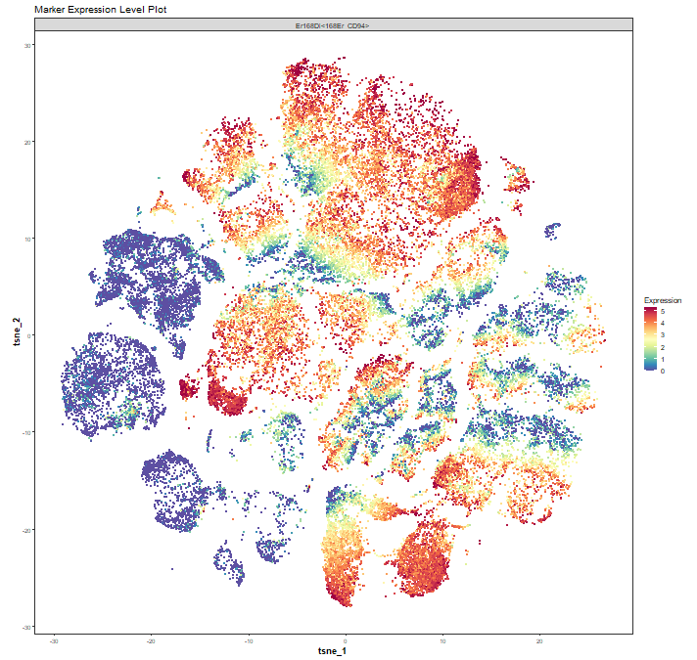
CD158b
NKG2D

Slide 17
Summary of Cluster Number and Level of Expression of Protein
Cluster 7: NKG2C+CD226+CD244+KLRG1+ NKG2D+ Non classical NK
Cluster 11: CD226-CD158b+CD244-KLRG1- NKG2D+ Classical NK
Cluster 16: CD226-CD244-KLRG1- NKG2D+ Unconventional NK
Cluster 19: CD161+CD226+CD244+KLRG1+ NKG2D+ Classical NK
Cluster 45 and 46: CD2+CD226+CD244+KLRG1+ NKG2D+ Non classical NK
Cluster 44: CD244+ KLRG1+ NKG2D+Non classical NK
Conclusion: CyTOF combined by machine learning helped us in identifying proteomics based biomarkers that are useful
In both test and therapeutics development in cancer therapy. It demonstrated the presence of NKG2D on NK cells as signal
for improved outcomes post immunotherapy targeting PD1/PD-L1 pathway.

